Slide 1

Social Innovation Project
Brenda Lim (1626935)
Wang Jiarui (1619816)
Audrey Yip (1634956)
Eugene Khoo (1625244)
Govin Pillai (1625541)
#Anti-Bully Event and Website

Slide 2

Bullying

Slide 3

Problems faced
Social
Physical
Identity
Communication
Emotional

Slide 4

Social
family members immersed in work and not able to help out
Peer pressure experienced

Slide 5
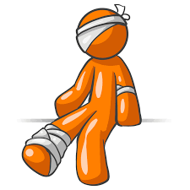
Physical
resorted to self harm
physical injuries sustained from the bullies

Slide 6

Identity
doesn’t want to be exposed
embarrassed about being a bullied victim

Slide 7

Communication
reluctant to interact with others
no friends to talk to
afraid to speak up

Slide 8

Emotional
low self esteem
depression
anger management problems

Slide 9
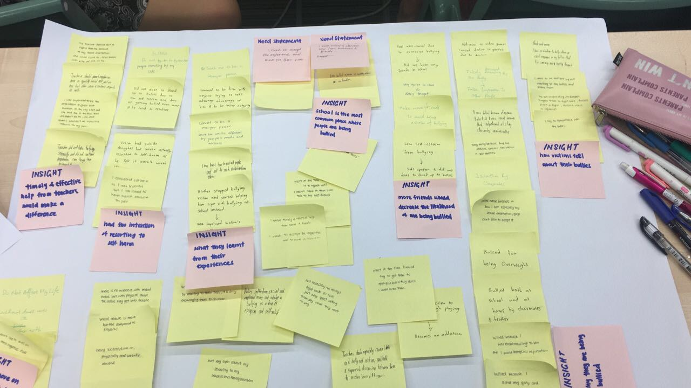

Slide 10

Insights gathered
timely & effective help from teachers would make a difference
had the intention of resorting to self harm
school is the most common place where people are being bullied
more friends would decrease the likelihood of being bullied

Slide 11
Problem Statement
How can we help bullied victims overcome their situation

Slide 12
Need Statement
I need to accept the experience and move on from now
I need timely and effective help from teachers and friends

Slide 13
Solution
An Event
A website

Slide 14
Our Event

Slide 15
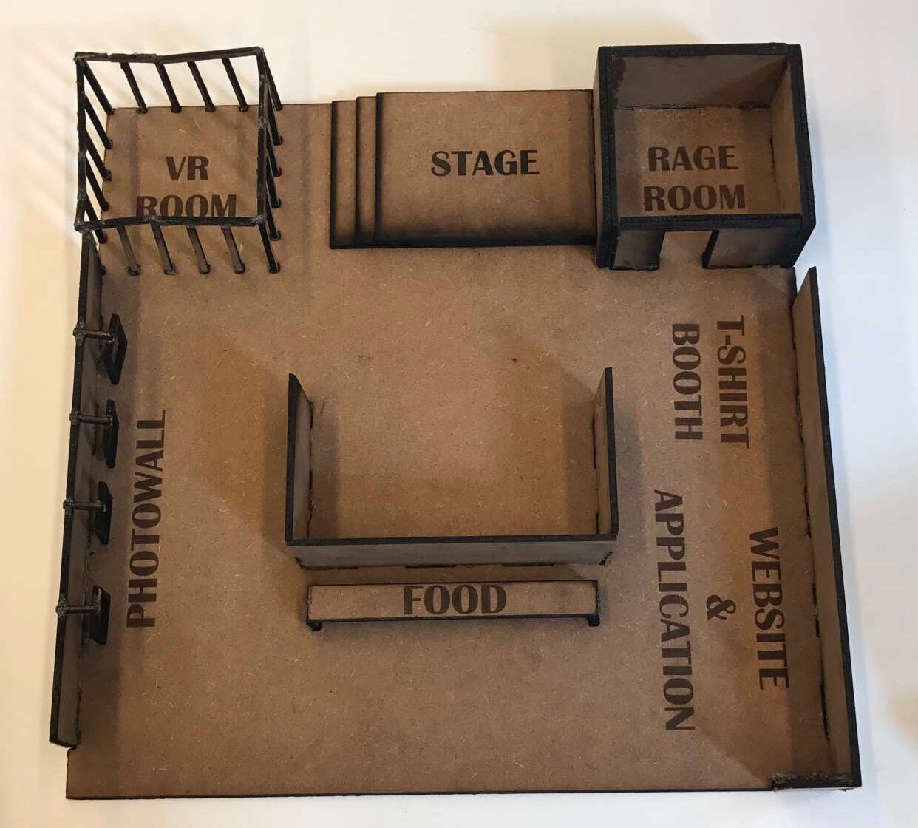
Photo Wall
Virtual Reality Room
Stage
Rage Room
T-Shirt Booth
Website and Application

Slide 16

Photo Wall
Guests can pose in front f the photo wall
Great way for guests to remember the event
Enhances exposure of organization

Slide 17

Virtual Reality Room
Guests can use Virtual Reality (VR) headsets to experience being in the shoes of a victim of bullying
Allows users to sympathise and understand the experience victims face
Spreads awareness regarding the plight of victims

Slide 18

Stage
Provide educational talks on bullying
Invite notable personalities
Learning opportunity for guests
Provides comfort to victims

Slide 19
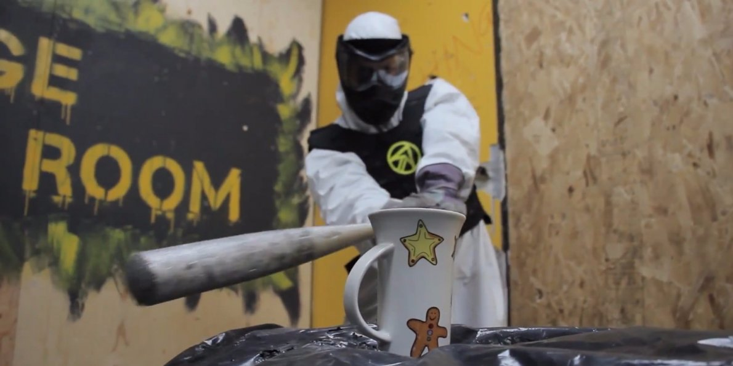
Rage Room
Provides victims of bullying with a way to release the suppressed emotions they possess
In a supervised environment
Does not endanger victim

Slide 20

T-Shirt Booth
Guests can purchase t-shirts
Great way for guests to remember their time at the event and show their support for our organization
Spreads awareness about our organization and cause amongst more people

Slide 21
Website
Guests can learn more about our online services
Guests can place donations to our organization
Victims can learn about our anonymous online counselling help desk
Victims can make use of the website to help them overcome their issues

Slide 22
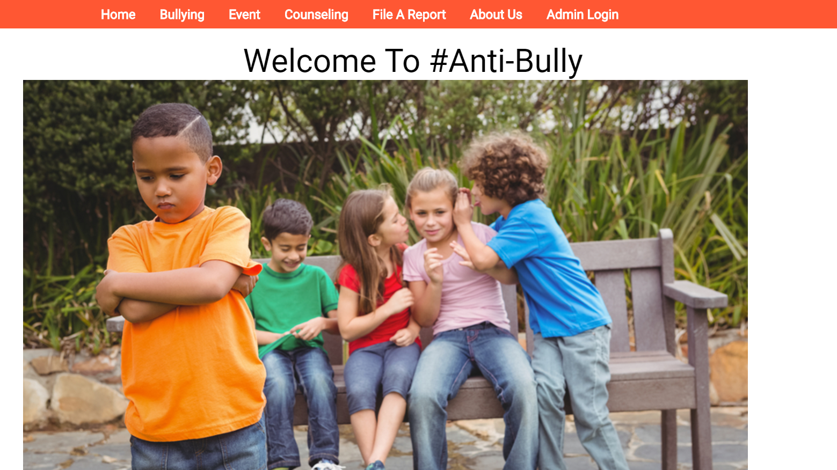
Website

Slide 23

Gallery Walk
Interviewees

Slide 24


Gallery Walk
What worked
Providing outlets
Rage Room
Raising awareness
VR Room
Mass Talk
Reaching out
Counsellors available
Website

Slide 25

Gallery Walk
What didn’t work
Photo Wall
Participation in the event
Website was similar to others in terms of bullying advice.

Slide 26

Interviewees
What worked
VR Room
Allows others to understand the bullied’s position better
Rage Room
Good for de-stressing and venting any pent up feelings

Slide 27
Interviewees
What didn’t work
Photo Wall
Shy to admit that they have been bullied before
Most bullied does not have active social media life, thus it doesn’t help in promoting the event

Slide 28

School Collaboration
Bully Prevention
Website Improvement
Goodie Bag

Slide 29

Collaboration With Educational Institutes
Have schools organise field trip
Raise awareness in schools
Tackling a major source of bullying

Slide 30

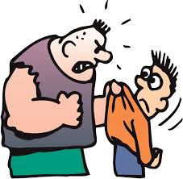
Bully Prevention
Prevention > Cure
Stop the vicious cycle of bullying
Give talks to schools

Slide 31

Website Improvement
Improve design
More interactive
Get people interested

Slide 32
Goodie Bags
Increase participation
Get more exposure

Slide 33

Reflection:
What is the team’s attitude towards making a difference in the community now compared to the start of the project?

Slide 34

It was just another module

Slide 35

Looking beyond our own perspectives

Slide 36

Make a difference in the community

Slide 37


